Slide 1

Input and output redirection
Nitin kunmar gaur
Abhisekh Kumar Yadav
Harsh Kumar
Manjunatha Durgesh

Slide 2
CONTENTS:
INTRODUCTION
INPUT REDIRECTION
HERE DOCUMENT
OUTPUT REDIRECTION
REDIRECTION COMMANDS

Slide 3
INTRODUCTION:
Most Unix system commands take input from your terminal and send the resulting output back to your terminal.
A command normally reads its input from the standard input, which happens to be your terminal by default. Similarly, a command normally writes its output to standard output, which is again your terminal by default.
Meta characters are used for redirection. A file (shell meta characters are angle brackets ", '>') or a programme (shell meta characters are pipesymbol '|') can be redirected to.

Slide 4
INPUT REDIRECTION
A command's output can be routed to a file, and a command's input can be diverted from a file.
The less than < character is used to redirect the command's input, just as the greater-than character > is used for output redirection.
The bash shell uses stdin to take input.
In this way, commands that ordinarily take their input from the standard input might have it redirected from a file.
For example, you can use the command to count the number of lines in the file users generated above:

Slide 5
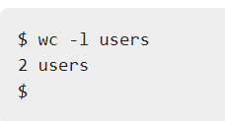
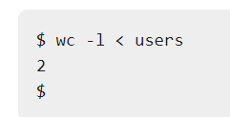
You will see the following output after running the command. By redirecting the standard input of the wc command from the file users, you may count the number of lines in the file.
Note that the output provided by the two forms of the wc command differs.
The name of the file users is listed with the line count in the first case, but not in the second.
In the first scenario, wc recognises that it is receiving data from file users. It only knows it's reading from standard input in the second case, thus it doesn't show the file name.

Slide 6
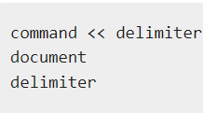
HERE DOCUMENT:
A here document is used to redirect input into a shell script or application that is interactive.
By providing the appropriate input for the interactive programme, or interactive shell script, we can run an interactive programme within a shell script without the need for human interaction.
The general form of command delimeter is :

Slide 7
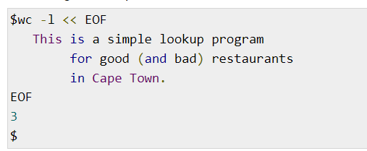
The shell understands the operator as a command to read input until it finds a line with the supplied delimiter.
The command's standard input receives all of the input lines up to the line containing the delimiter.
The delimiter informs the shell that the document in this location is complete. Without it, the shell will keep reading the input indefinitely. The delimiter must be a single word with no spaces or tabs in it.
Following is the input to the command wc -l to count the total number of lines −

Slide 8

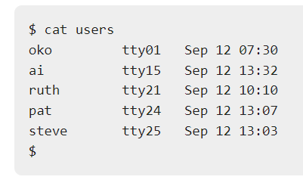
OUTPUT REDIRECTION:
A command's output can easily be diverted to a file instead of being sent to standard output.
Output redirection is the name for this feature.Any command that typically publishes its output to standard output will have its output written to file instead of your terminal if the notation > file is appended to it.
Check out the who command, which transfers the command's whole output to the users file.
Notice that no output appears at the terminal.This is because the output has been redirected from the default standard output device (the terminal) into the specified file.

Slide 9
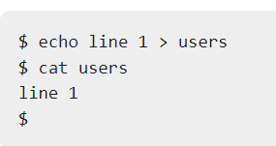
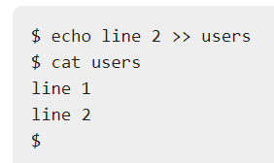
If the output of a command is redirected to a file that already contains data, that data will be lost.
To append the output to an existing file, use the >> operator.

Slide 10
Discarding Output:
You may occasionally need to run a command but do not want the results displayed on the screen. You can discard the output by diverting it to the file /dev/null in such instances.
$ command /dev/null
The name of the command you want to run is entered here. The file /dev/null is a special file that discards all of its input automatically.
Use standard redirection to redirect STDERR to STDOUT to delete both a command's output and its error output.
$ command > /dev/null 2>&1
STDERR is represented by 2 while STDOUT is represented by 1.

Slide 11
REDIRECTION COMMANDS:
pgm > file
Output of pgm is redirected to file.
pgm < file
Program pgm reads its input from file.
pgm >> file
Output of pgm is appended to file.
n > file
Output from stream with descriptor n redirected to file.
n >> file
Output from stream with descriptor n appended to file.

Slide 12
n >& m
Merges output from stream n with stream m 7
n <& m
Merges input from stream n with stream m 8
<< tag
Standard input comes from here through next tag at the start of line 9
|
Takes output from one program, or process, and sends it to another file Program pgm reads its input from file

Slide 13
Thank you

